Slide 1
ESP8266 Tutorial
(Web server)

Slide 2
ESP8266 Tutorial (As Web server)
Part I . Updating Firmware NodeMCU
A. Connection Diagram
B. Procedure (Using Flasher)
Part II. Using ESPlorer.
A. Connection Diagram
B. How to Reset ESP
C. Save to ESP
D. Sample Program (As Webserver)

Slide 3
Updating Firmware NodeMCU
A. Connection Diagram(Using USB-to-UART converter)
RX
TX
GND
GND
GND
TXD0
RXD0
GPIO0
GPIO15
GND
EN
VCC
+3.3V
+3.3V

Slide 4
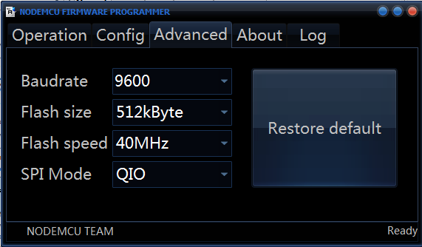
Updating Firmware NodeMCU
B. Procedure
1. Open ESP8266Flasher.(x32) or (x64).
2. ADVANCED set Baudrate, Flash size, Flash speed, SPI Mode.

Slide 5
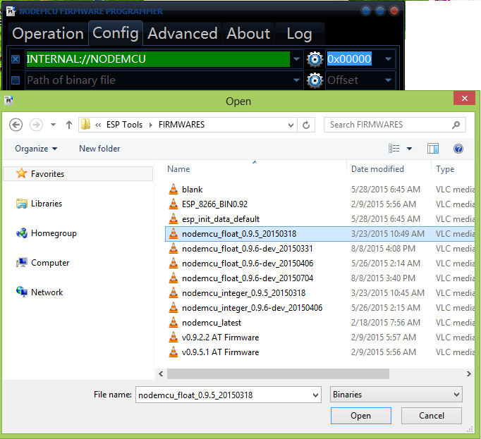
Updating Firmware NodeMCU
3. CONFIG
Click This!
Select
nodemcu_float_
0.9.5_20150318.bin

Slide 6
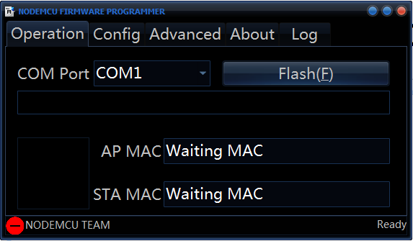
Updating Firmware NodeMCU
4. OPERATION
Select
COM#
Click “Flash”
Then wait to Finish bootloading...
After the bootload is done, disconnect GPIO0 and GPIO15 to the GND.

Slide 7
Using ESPlorer
A. Connection Diagram
RX
TX
GND
GND
TXD0
RXD0
GPIO2
GND
EN
VCC
+3.3V
+3.3V

Slide 8
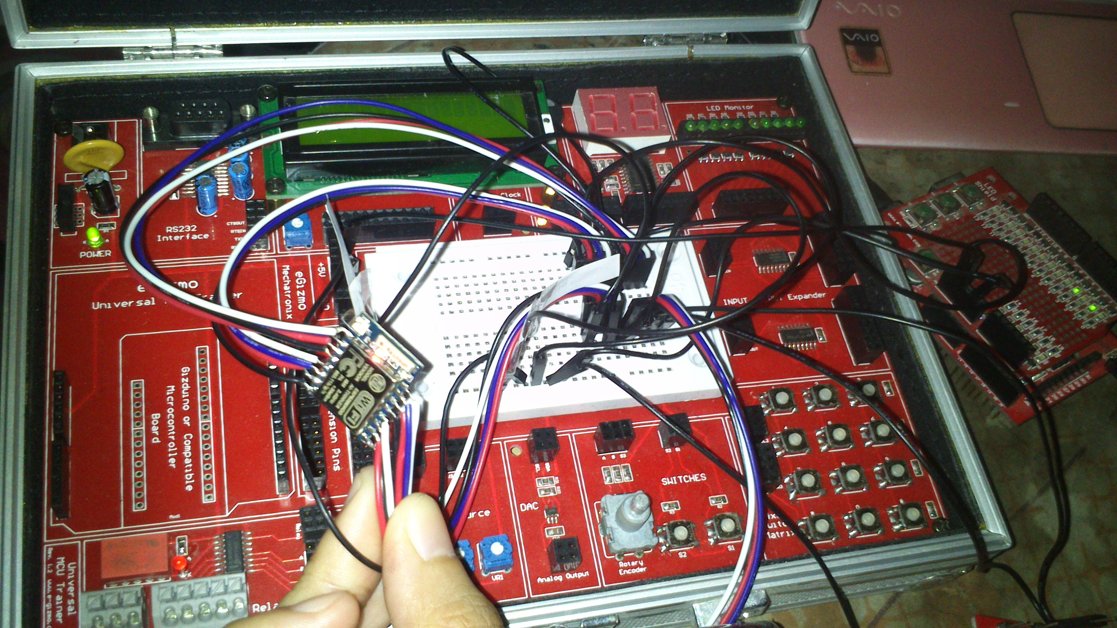
Im using the LED monitor of UMT Trainer for my experiment. The supply I used is also
From gizDuino Power (+5V dc) to power the UMT.
Note: Im using +3v3 Power Supply of gizDuino. Not from the +3.3V of USB-to-TLL
Converter. Then Common GND.

Slide 9
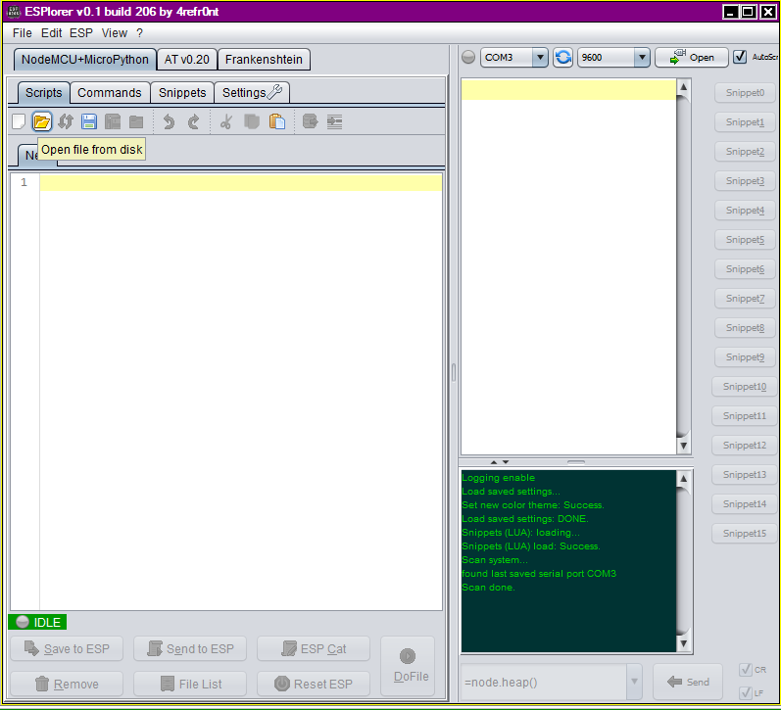
Now Open ESPlorer

Slide 10
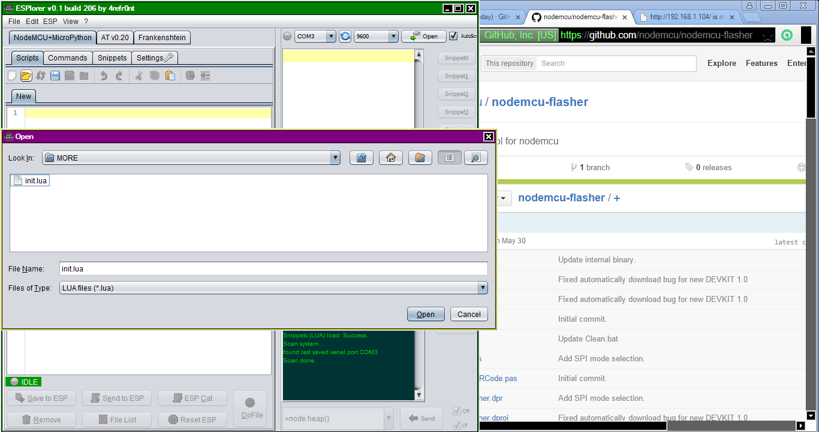
Open init.lua sample

Slide 11
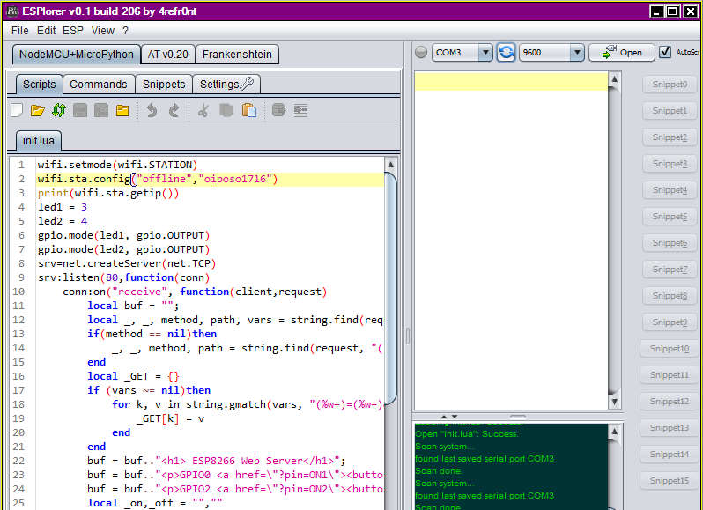
Place (“Your_SSID”,”Password”), then click “OPEN”

Slide 12
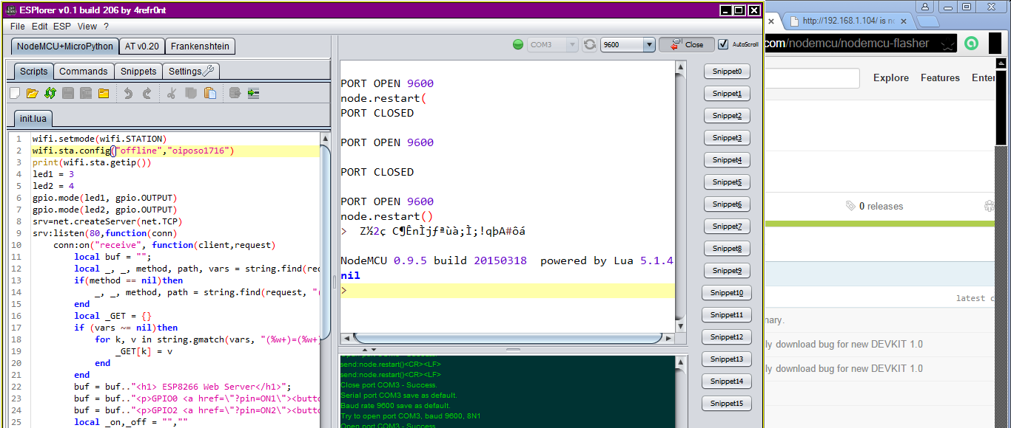

Click Reset ESP

Slide 13
A. In Connection Diagram
Connect GPIO0 To GND.
RX
TX
GND
GND
GND
TXD0
RXD0
GPIO0
GPIO2
GND
EN
VCC
+3.3V
+3.3V

Slide 14
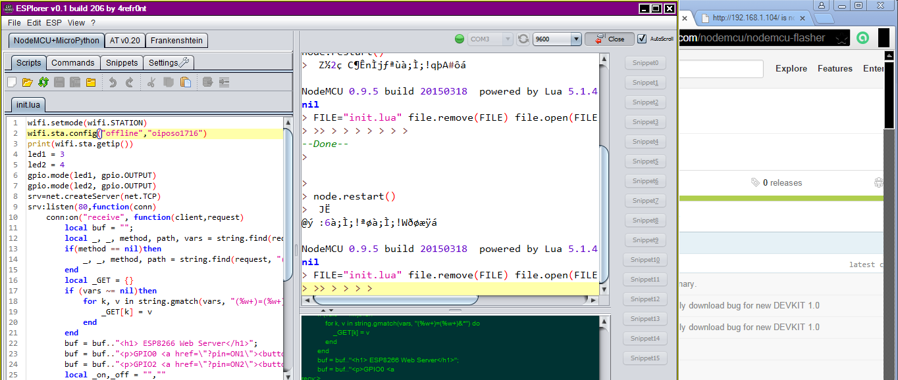

Click “Save to ESP”

Slide 15
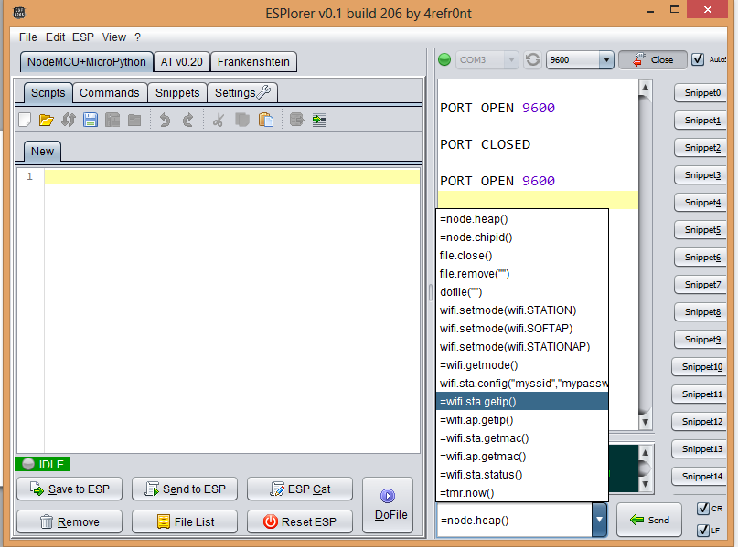
Select “=wifi.sta.getip()”, then Click “Send”

Slide 16
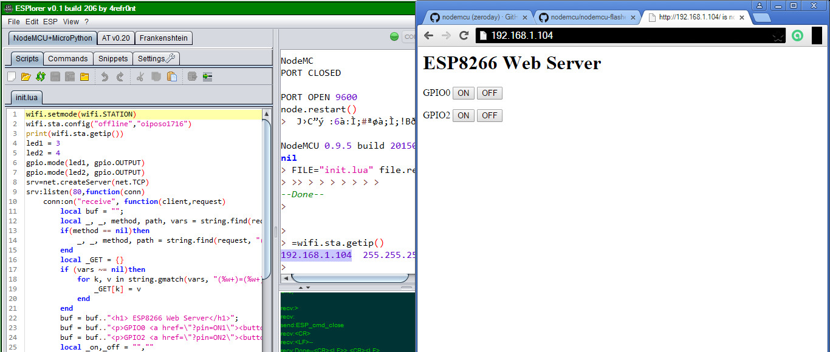
The IP address is shown, then Goto browser.
DONE! Enjoy ;-)

